Slide 1
Prague: High Performance Heterogeneity-Aware Asynchronous Decentralized Training
Qinyi Luo, Jiaao He, Youwei Zhuo, Xuehai Qian
University of Southern California and Tsinghua University

Slide 2
The Problem
Data Parallelism is a very useful procedure for training DNNs to convergence faster but there are limits to the current state of the art methods.
“Stragglers” (the slowest workers) are at the heart of the issue.
The baseline method is the outdated Parameter Server method where a single centralized server handles all worker communication and synchronization messages.
The all-reduce method works well when all workers / networks perform similarly but is fundamentally limited to the speed of the slowest worker (the straggler).
The AD-PSGD method handles heterogeneous environments and provides significant speed-up over baseline, but falls far short of the speed of All-Reduce in homogeneous environments.

Slide 3
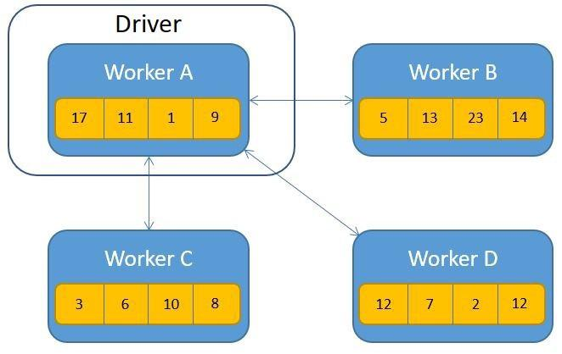
Parameter Server Algorithm
Reference algorithm.
Single Worker handles all communication and synchronizes with all other workers.
Very high communication overhead.

Slide 4
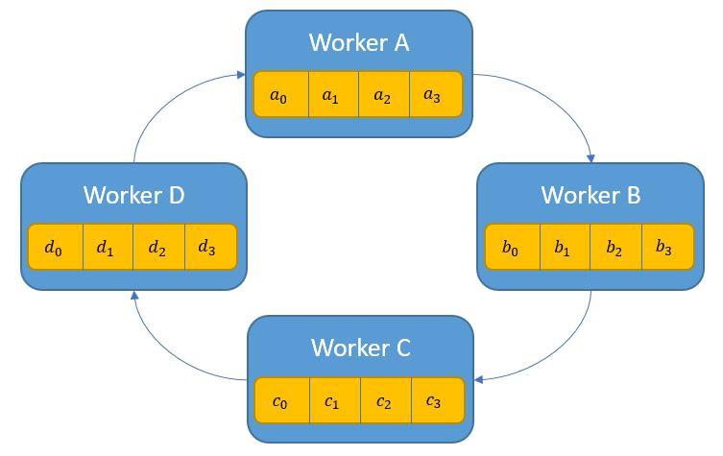
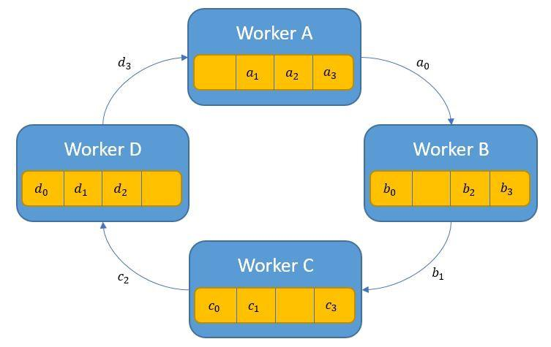
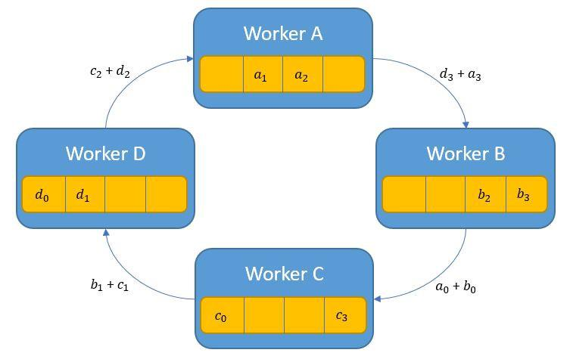
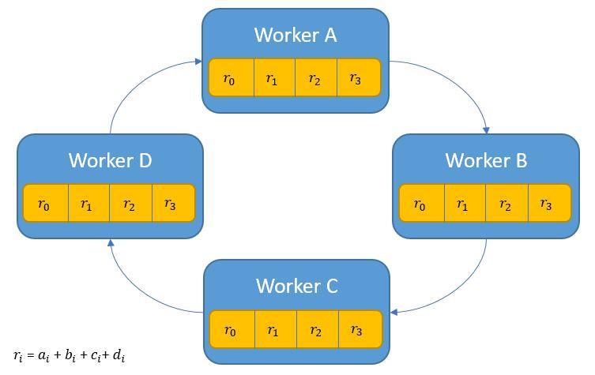
All-reduce Algorithm (Ring All-reduce)
Best suited to homogeneous environments.
Computation is evenly distributed across workers.
Each step is finished in the time it takes the slowest worker to complete.
Step 0
Step 1
Step 2
Step n

Slide 5
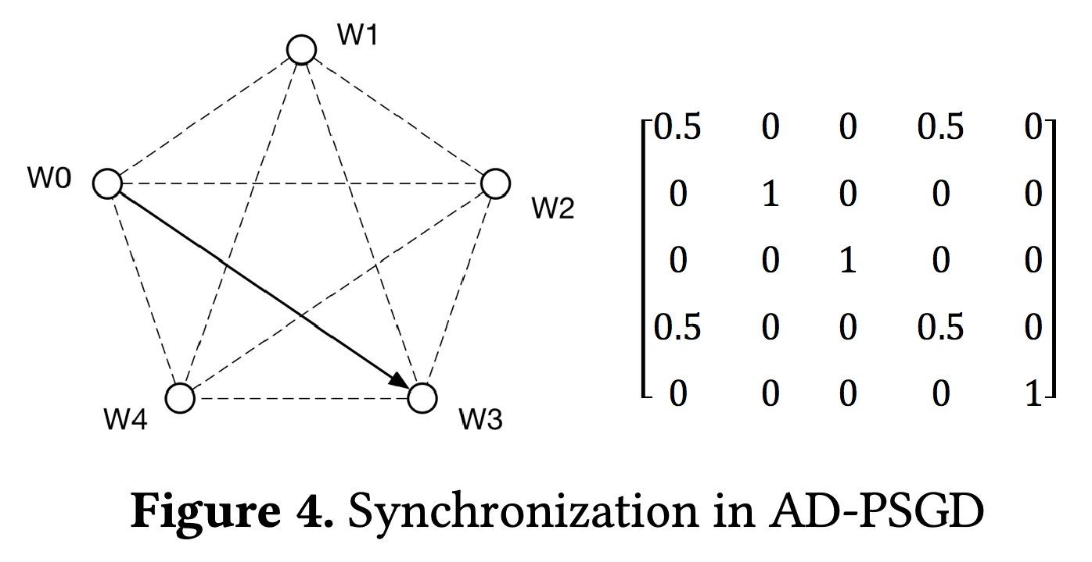
AD-PSGD Algorithm
Asynchronous Decentralized Parallel Stochastic Gradient Descent
After completing SGD each node randomly selects another node and synchronizes with just that node.
An adjustment to the original algorithm splits the graph equally into active and passive worker groups. Only the active group initiates synchronization. This reduced the chances of deadlock.
Notes:
Uses blocking mechanisms to ensure sequence is respected.
Can result in deadlocks.

Slide 6
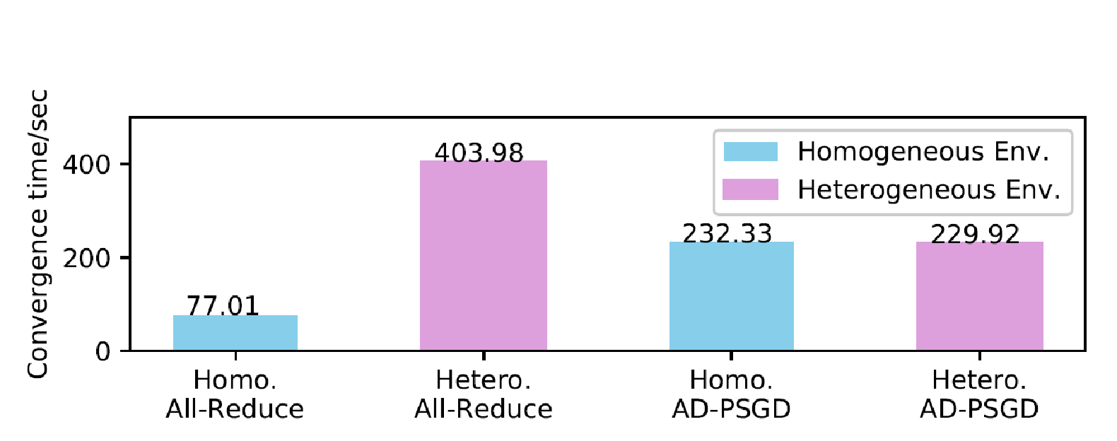
All-Reduce vs. AD-PSGD
All-Reduce performs well in homogeneous environments but not heterogeneous.
AD-PSGD has much higher communication costs and but is resilient to heterogeneous environments

Slide 7
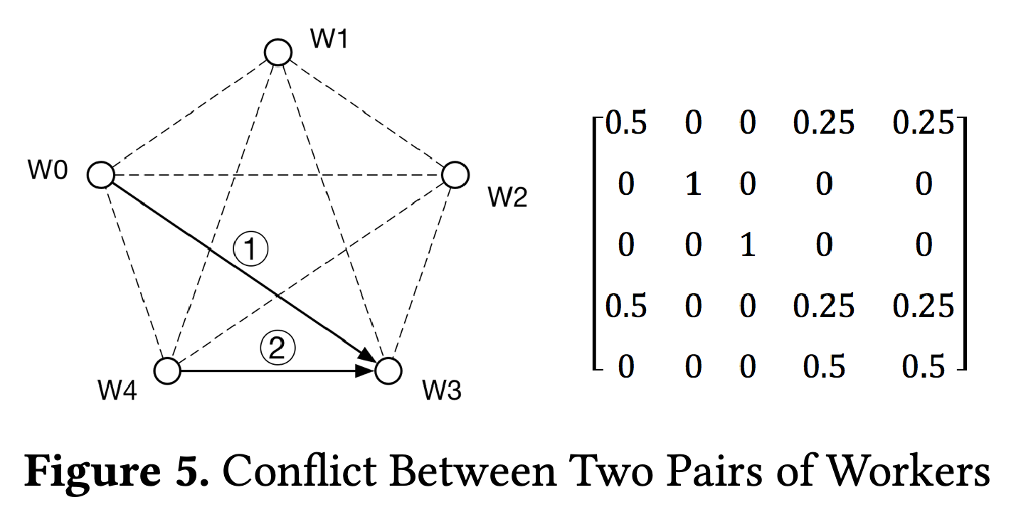
Inefficiency in AD-PSGD
In cases where multiple active nodes select the same passive node to synchronize with the operations are done sequentially rather than as a group.

Slide 8
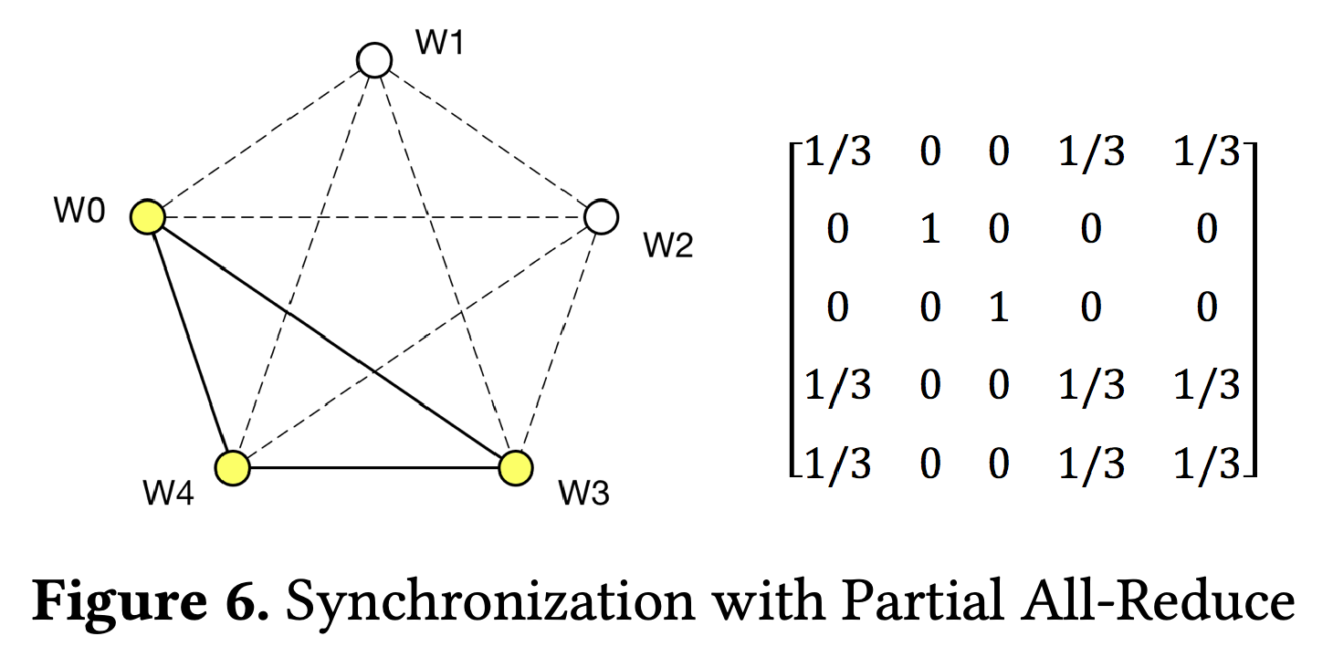
Partial All-Reduce
Apply All-Reduce at the group level
Generate groups to synchronize with a random or “smart” method.
Get the best of All-Reduce and remain resilient to “stragglers”.

Slide 9
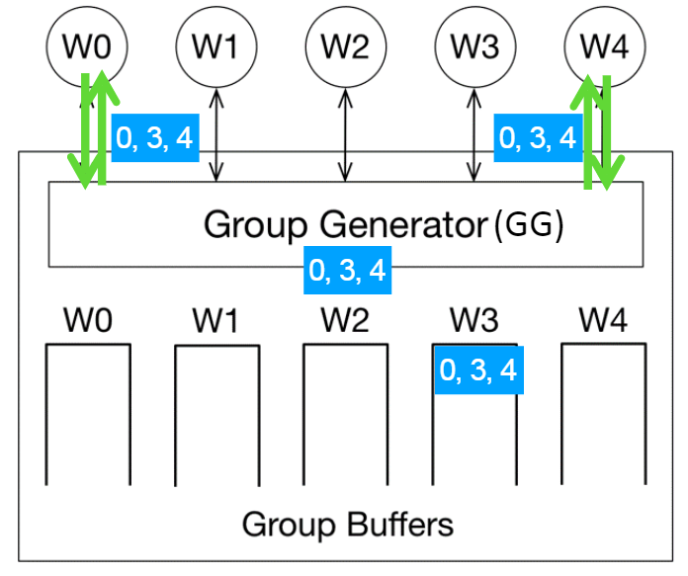
Prague System Design
Worker:
Compute & apply gradients locally to update model parameters.
Sync group information from the GG.
Perform P-Reduce collectively with other group members.

Slide 10
Prague System Design
Group Generator (GG):
Return the associated group associated with the requester (if previously created).
For the first time request, generate a new group.

Slide 11
Prague System Design
Group Generator (GG):
Challenge:
group generator strategy, e.g., avoiding conflict among groups
Straggler Problem

Slide 12
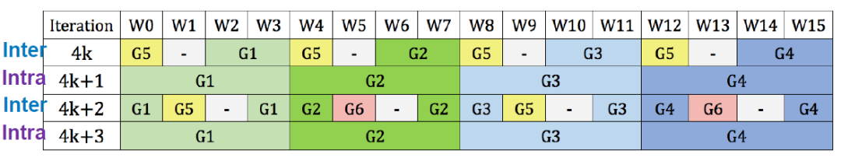
Conflict Avoidance
Conflict-Free Grouping
Manually implemented by static GG (Fixed Schedule)
Cost of conflict-avoidance is cheaper.
Weaker resistance to stragglers.

Slide 13
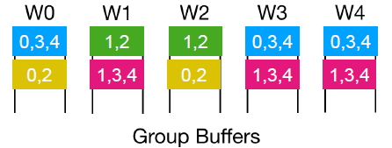
Conflict Avoidance
Randomized Schedule
Puts forward the idea of Group Division (GD)
Generates 1 random division at a time: computes group for all nodes simultaneously (bias-avoidance)

Slide 14
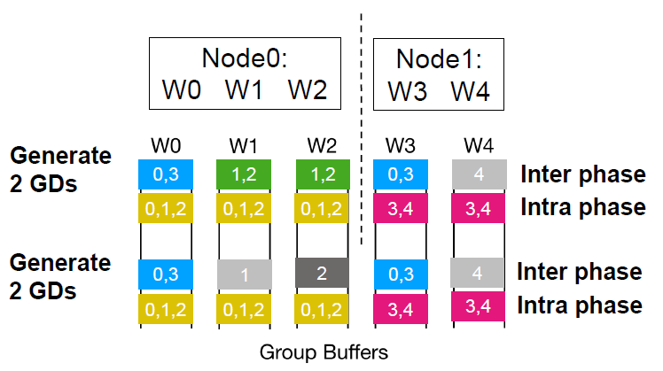
Conflict Avoidance
Inter-Intra Synchronization
Alternates between inter-intra when generating groups.
Improved Performance

Slide 15
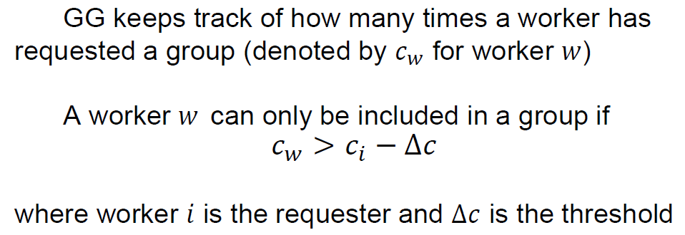
Tolerating Stragglers
Applies threshold rule method
Avoids putting slow workers and fast workers in the same group.
Provides slow workers with leeway to ‘catch up’ with other workers.

Slide 16
System Implementations
Implemented as customized TensorFlow operator
P-Reduce uses NCCL as the backend & creates NCCL communicator through MPI
GG uses gRPC python package
Supports 2 implementations of the Prague:
Static GG: group schedules are manually designed.
Smart GG: implements randomized schedules (incl randomized group division, inter-intra synchronization, & threshold rule.

Slide 17
System Implementations
Implements two baseline algorithms
All-Reduce: Horovod with NCCL backend on TensorFlow
AD-PSGD: TensorFlow remote variable access

Slide 18
Experiments
Models and datasets used
Vision: VGG-16 on CIFAR-10; Resnet-18, Resnet-50 and Resnet-200 on ImageNet
NLP: Transformer on News-Commentary dataset
Modeling Heterogeneity
Adding Artificial Slowdown:
each i.i.d. worker slows down with a probability of 1/(#workers)

Slide 19
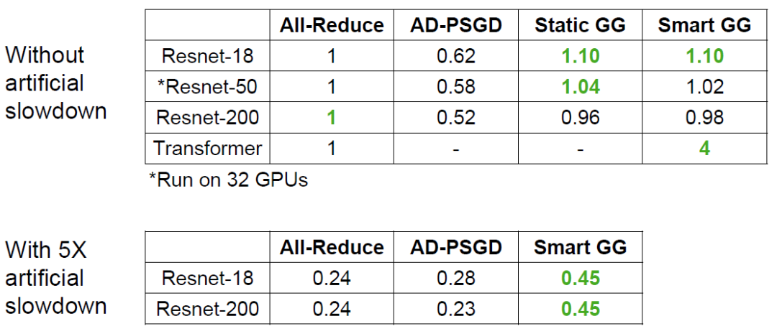
Results
Throughput
Modeled with and without slowdown

Slide 20
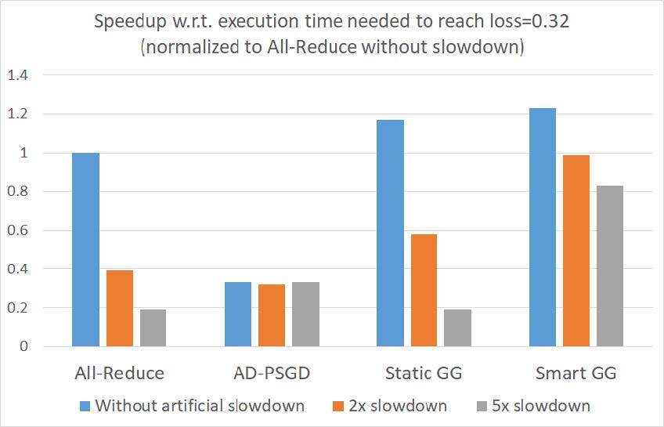
Results
2. Convergence
Time required to attain a desired loss (for VGG-16)

Slide 21
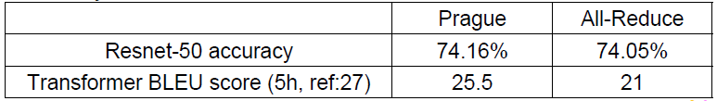
Results
3. Accuracy of the final model

Slide 22
Conclusion
Proposed Prague as a high-performance heterogeneity-aware asynchronous decentralized training approach.
Introduced a novel communication primitive and randomized Partial All-Reduce (P-Reduce), to lower communication costs.
Designed smart group generation strategies to eliminate conflicts & tolerate stragglers.
Without loss in utility to All-Reduce in homogeneous environments, Prague displayed superior tolerance towards stragglers.

Slide 23
Limitations
Experiments have been performed with only a single slowdown rate, hence the speedup claims may not be consistent.
The final accuracy of both ResNet-50 and Transformer models is without the artificial slowdown. The claims that the proposed approach can achieve the same accuracy in a time-bounded fashion to P-Reduce may not be valid throughout.

